Slide 1

Planning in the Era of Language Models
ICAPS 2026 Summer School
Michael Katz, IBM

Slide 2
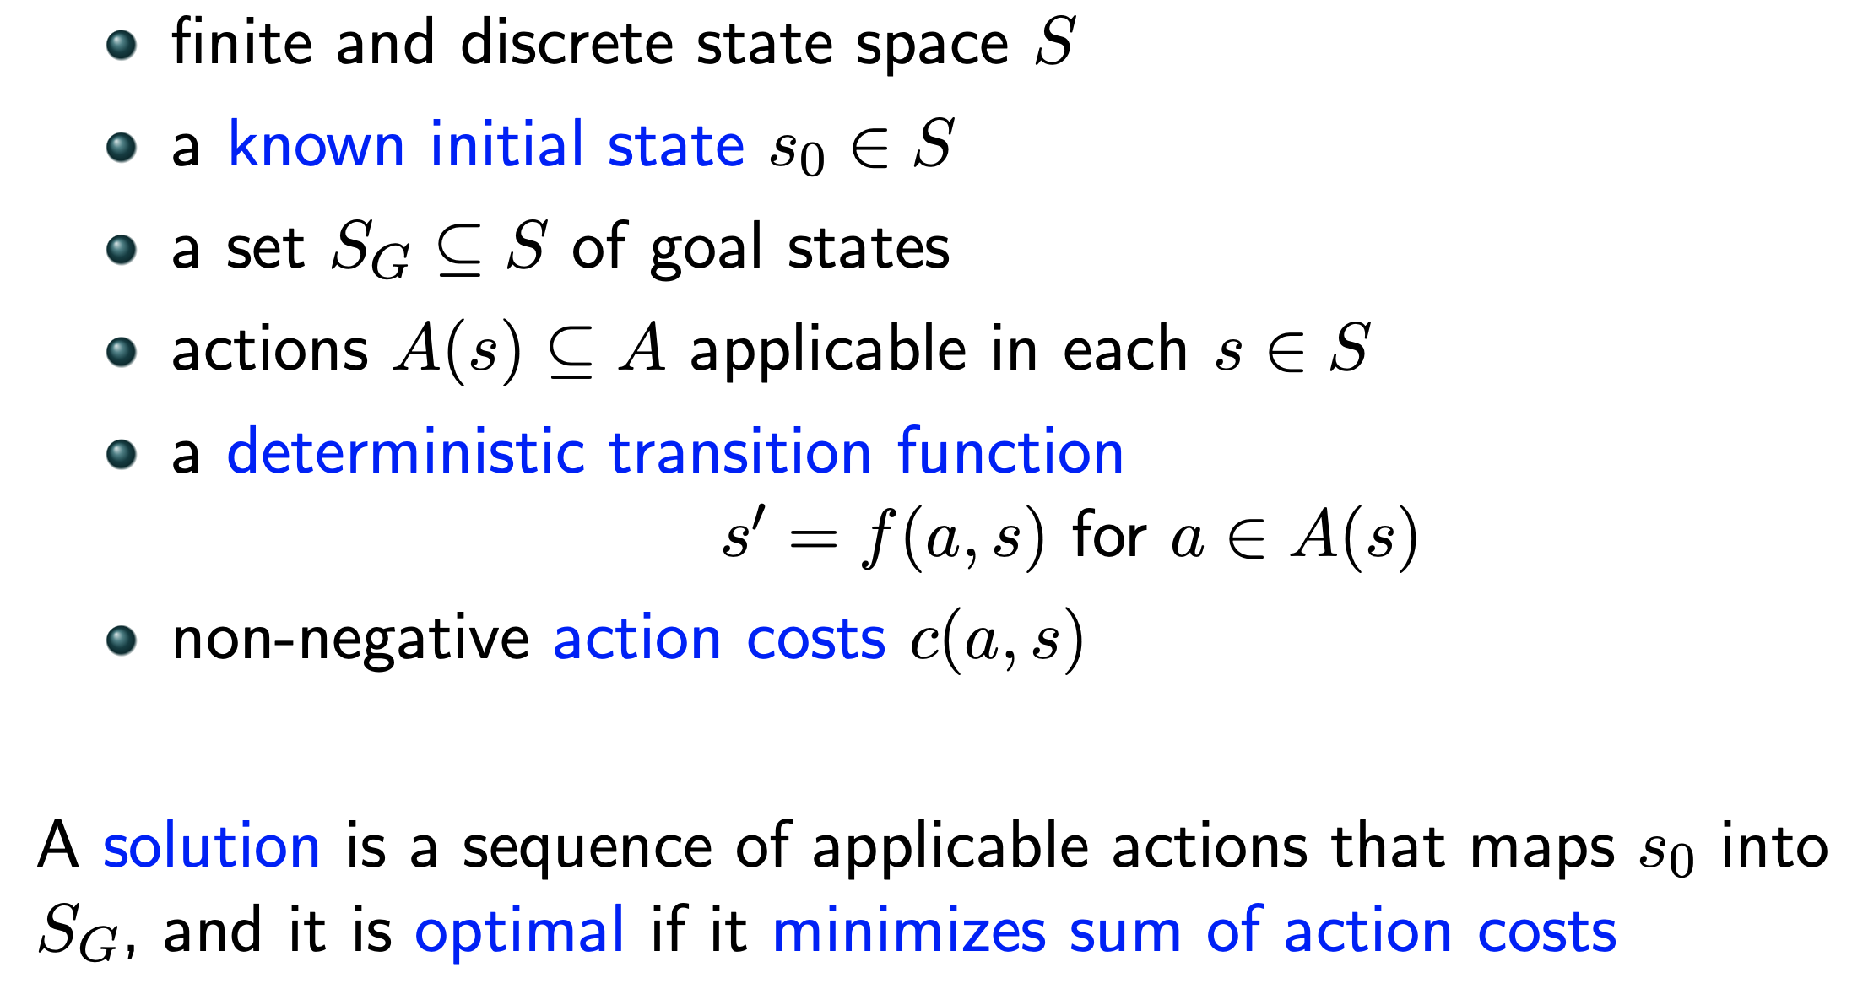
Planning problem
Mathematical Model:

Slide 3
Planning problem
Mathematical Model:
Black Box
goal: S -> {T,F}
succ: S ->2^{SxA}

Slide 4
Planning problem
Mathematical Model:
Planning Language
types
objects
predicates
initial state
actions
goal
preconditions
effects
Black Box
goal: S -> {T,F}
succ: S ->2^{SxA}

Slide 5
Planning problem
The 24 Game is a mathematical card game in which the objective
is to find a way to manipulate four integers so that the end result is 24.
The game is played with a list of four numbers, and the player must use all four numbers exactly once, using any combination of addition, subtraction, multiplication, or division, to arrive at the number 24.
Mathematical Model:
Planning Language
types
objects
predicates
initial state
actions
goal
preconditions
effects
Black Box
goal: S -> {T,F}
succ: S ->2^{SxA}

Slide 6
Planning problem
The 24 Game is a mathematical card game in which the objective
is to find a way to manipulate four integers so that the end result is 24.
The game is played with a list of four numbers, and the player must use all four numbers exactly once, using any combination of addition, subtraction, multiplication, or division, to arrive at the number 24.
Mathematical Model:
Planning Language
types
objects
predicates
initial state
actions
goal
preconditions
effects
Black Box
goal: S -> {T,F}
succ: S ->2^{SxA}

Slide 7
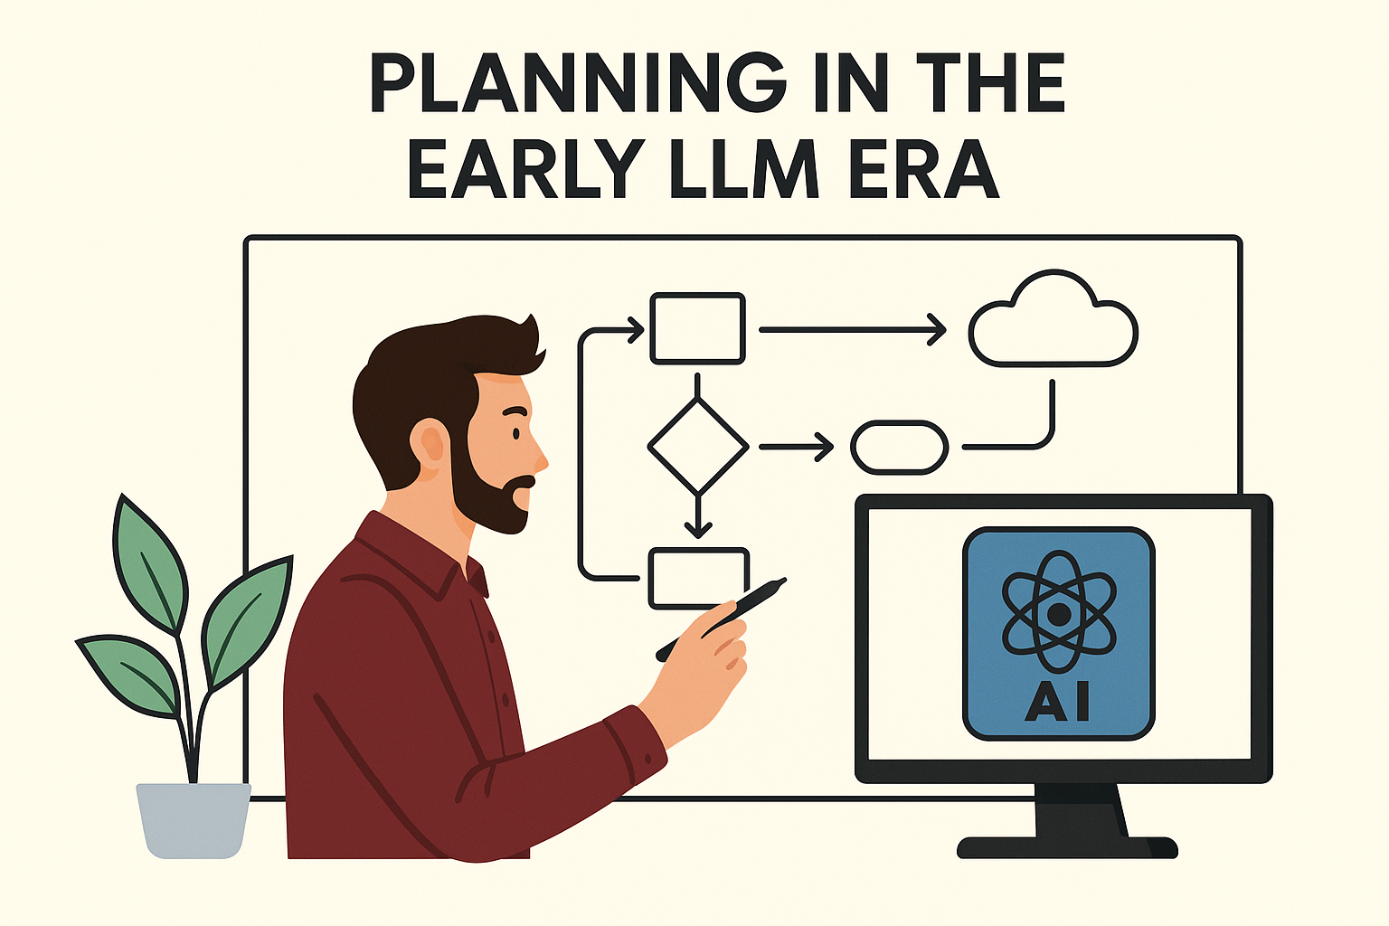

Slide 8

Solving NL/PDDL planning problems
Environment
Planning/search problem in NL

Slide 9



Solving NL/PDDL planning problems
Environment
Most of the focus since 2022
LLM as Planner
Observation
Previous lecture by Augusto Corrêa
Planning/search problem in NL
Action/plan

Slide 10

Solving NL/PDDL planning problems
Environment
Most of the focus since 2022
LLM as Planner
Observation
Previous lecture by Augusto Corrêa
Planning/search problem in NL
Action/plan
LLM as search components (World Models)
Observation
Action/plan
Search algorithm

Slide 11
Solving NL/PDDL planning problems
Environment
Most of the focus since 2022
LLM as Planner
Observation
Previous lecture by Augusto Corrêa
Planning/search problem in NL
Action/plan
Yao et al. ICLR 2023
LLM as search components (World Models)
Xu et al. Arxiv 2023
Hao et al. EMNLP 2023
Observation
Yao et al. NeurIPS 2023
Shinn et al. NeurIPS 2023
Zhou et al. ICML 2024
Action/plan
Sel et al. ICML 2024
Search algorithm
Besta et al. AAAI 2024

Slide 12
LLM as a World Model
Yao et al. ICLR 2023
LLM as search components (World Models)
Environment
Xu et al. Arxiv 2023
Hao et al. EMNLP 2023
Observation
Yao et al. NeurIPS 2023
Shinn et al. NeurIPS 2023
Zhou et al. ICML 2024
Action/plan
Planning/search problem in NL
Sel et al. ICML 2024
Search algorithm
Besta et al. AAAI 2024
Notes:
Let’s imitate search: LLMs as world models + external search, works in 24Game

Slide 13
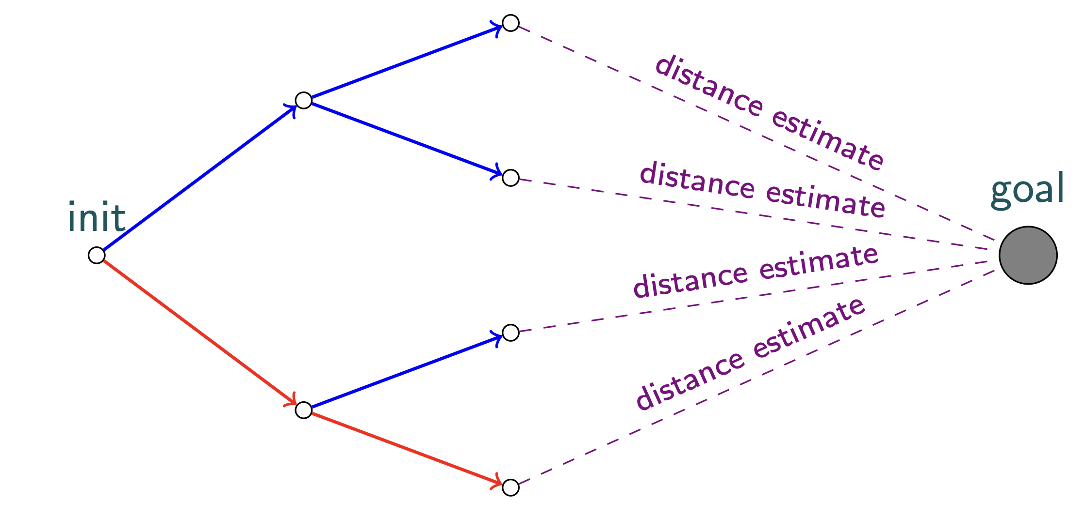
LLM as a World Model
Yao et al. ICLR 2023
LLM as search components (World Models)
Environment
Xu et al. Arxiv 2023
Hao et al. EMNLP 2023
Observation
Yao et al. NeurIPS 2023
Shinn et al. NeurIPS 2023
Zhou et al. ICML 2024
Action/plan
Planning/search problem in NL
Sel et al. ICML 2024
Search algorithm
Besta et al. AAAI 2024
Notes:
Let’s imitate search: LLMs as world models + external search, works in 24Game

Slide 14
LLM as a World Model
Yao et al. ICLR 2023
LLM as search components (World Models)
Environment
Xu et al. Arxiv 2023
Hao et al. EMNLP 2023
Observation
Yao et al. NeurIPS 2023
Shinn et al. NeurIPS 2023
Zhou et al. ICML 2024
Action/plan
Planning/search problem in NL
Sel et al. ICML 2024
Search algorithm
Besta et al. AAAI 2024
Ask LLM
Notes:
Let’s imitate search: LLMs as world models + external search, works in 24Game

Slide 15
LLM as a World Model
Yao et al. ICLR 2023
LLM as search components (World Models)
Environment
Xu et al. Arxiv 2023
Hao et al. EMNLP 2023
Observation
Yao et al. NeurIPS 2023
Shinn et al. NeurIPS 2023
Zhou et al. ICML 2024
Action/plan
Planning/search problem in NL
Sel et al. ICML 2024
Search algorithm
Besta et al. AAAI 2024
Ask LLM
Ask LLM
Notes:
Let’s imitate search: LLMs as world models + external search, works in 24Game

Slide 16
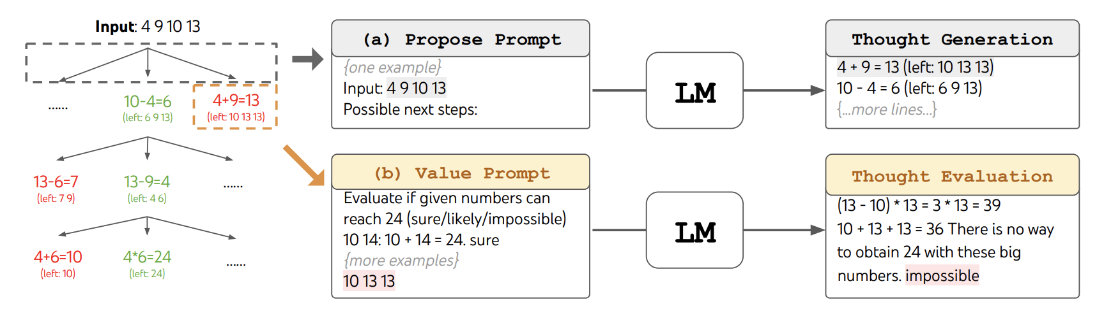
LLM as a World Model
Yao et al. ICLR 2023
LLM as search components
Environment
Xu et al. Arxiv 2023
Hao et al. EMNLP 2023
Observation
Yao et al. NeurIPS 2023
Shinn et al. NeurIPS 2023
Zhou et al. ICML 2024
Action/plan
Planning/search problem in NL
Sel et al. ICML 2024
Search algorithm
Besta et al. AAAI 2024
From: Yao et. al., NeurIPS 2023, Tree of Thoughts: Deliberate Problem Solving with Large Language Models
Notes:
These methods differ mainly in which search components are delegated to the LLM. ReAct uses the LLM as an online policy. ReWOO uses it as a plan/program generator. ToT uses it as a successor generator and heuristic evaluator inside classical tree search. RAP and LATS add MCTS, with the LLM acting as policy, value function, and sometimes world model. GoT generalizes the search structure from trees to graphs, using LLM calls as graph transformations. Reflexion adds meta-level plan repair by storing natural-language lessons from failed episodes.

Slide 17
LLM as a World Model
Yao et al. ICLR 2023
LLM as search components
Environment
Xu et al. Arxiv 2023
Hao et al. EMNLP 2023
Observation
Yao et al. NeurIPS 2023
Shinn et al. NeurIPS 2023
Zhou et al. ICML 2024
Action/plan
Planning/search problem in NL
Sel et al. ICML 2024
Search algorithm
Besta et al. AAAI 2024
Notes:
These methods differ mainly in which search components are delegated to the LLM. ReAct uses the LLM as an online policy. ReWOO uses it as a plan/program generator. ToT uses it as a successor generator and heuristic evaluator inside classical tree search. RAP and LATS add MCTS, with the LLM acting as policy, value function, and sometimes world model. GoT generalizes the search structure from trees to graphs, using LLM calls as graph transformations. Reflexion adds meta-level plan repair by storing natural-language lessons from failed episodes.

Slide 18
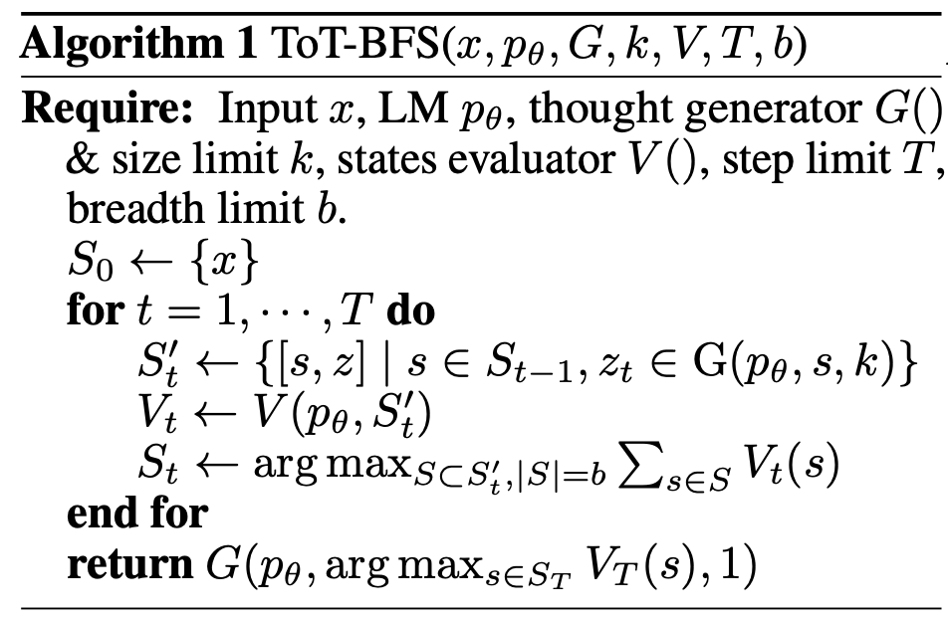
LLM as a World Model
Yao et al. ICLR 2023
LLM as search components
Environment
Xu et al. Arxiv 2023
Hao et al. EMNLP 2023
Observation
Yao et al. NeurIPS 2023
Shinn et al. NeurIPS 2023
Zhou et al. ICML 2024
Action/plan
Planning/search problem in NL
Sel et al. ICML 2024
Search algorithm
Besta et al. AAAI 2024
From: Yao et. al., NeurIPS 2023, Tree of Thoughts: Deliberate Problem Solving with Large Language Models
Notes:
These methods differ mainly in which search components are delegated to the LLM. ReAct uses the LLM as an online policy. ReWOO uses it as a plan/program generator. ToT uses it as a successor generator and heuristic evaluator inside classical tree search. RAP and LATS add MCTS, with the LLM acting as policy, value function, and sometimes world model. GoT generalizes the search structure from trees to graphs, using LLM calls as graph transformations. Reflexion adds meta-level plan repair by storing natural-language lessons from failed episodes.

Slide 19
What are the properties of these algorithms?
Sound?
Notes:
Partial awakening
LLMs can’t plan!
Some of these ideas are recklessly inefficient!
Why did it work in the first place?

Slide 20
What are the properties of these algorithms?
Sound?
No!
Notes:
Partial awakening
LLMs can’t plan!
Some of these ideas are recklessly inefficient!
Why did it work in the first place?

Slide 21
What are the properties of these algorithms?
Sound?
No!
If validator exists, we can make it sound
Notes:
Partial awakening
LLMs can’t plan!
Some of these ideas are recklessly inefficient!
Why did it work in the first place?

Slide 22
What are the properties of these algorithms?
Sound?
No!
If validator exists, we can make it sound
Complete?
Notes:
Partial awakening
LLMs can’t plan!
Some of these ideas are recklessly inefficient!
Why did it work in the first place?

Slide 23
What are the properties of these algorithms?
Sound?
No!
If validator exists, we can make it sound
Complete?
No!
Notes:
Partial awakening
LLMs can’t plan!
Some of these ideas are recklessly inefficient!
Why did it work in the first place?

Slide 24
What are the properties of these algorithms?
Sound?
No!
If validator exists, we can make it sound
Complete?
No!
Optimal?
Notes:
Partial awakening
LLMs can’t plan!
Some of these ideas are recklessly inefficient!
Why did it work in the first place?

Slide 25
What are the properties of these algorithms?
Sound?
No!
If validator exists, we can make it sound
Complete?
No!
Optimal?
No!
Notes:
Partial awakening
LLMs can’t plan!
Some of these ideas are recklessly inefficient!
Why did it work in the first place?

Slide 26
What are the properties of these algorithms?
Sound?
No!
If validator exists, we can make it sound
Complete?
No!
Optimal?
No!
Computational complexity?
Hard to measure. Most expensive operation is LLM call
Computational effort vs. state space portion explored
Notes:
Partial awakening
LLMs can’t plan!
Some of these ideas are recklessly inefficient!
Why did it work in the first place?

Slide 27
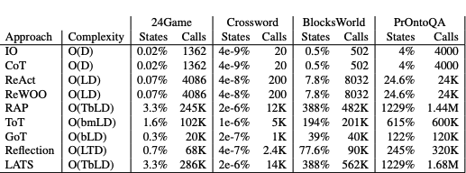
What are the properties of these algorithms?
Sound?
No!
If validator exists, we can make it sound
Complete?
No!
Optimal?
No!
Computational complexity?
Hard to measure. Most expensive operation is LLM call
Computational effort vs. state space portion explored
Katz et al, NeurIPS 2024, Thought of Search: Planning with Language Models Through The Lens of Efficiency
Notes:
Partial awakening
LLMs can’t plan!
Some of these ideas are recklessly inefficient!
Why did it work in the first place?

Slide 28
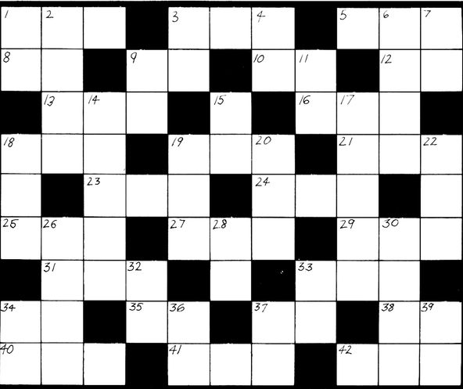
Why did it work in the first place?
3
24 4
5

Slide 29
Why did it work in the first place?
3
24 4
5
Tested on data scraped from the internet
Data contamination concerns
No external validator, lenient success criteria

Slide 30
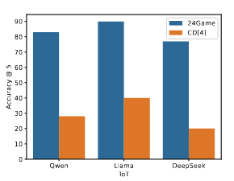
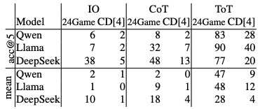
Why did it work in the first place?
3
24 4
5
Tested on data scraped from the internet
Data contamination concerns
No external validator, lenient success criteria
Katz et al, ICLR 2026 Workshop World Models, Seemingly Simple Planning Problems are Computationally Challenging: The Countdown Game

Slide 31
Why did it work in the first place?
3
24 4
5
Tested on data scraped from the internet
Data contamination concerns
No external validator, lenient success criteria
Katz et al, ICLR 2026 Workshop World Models, Seemingly Simple Planning Problems are Computationally Challenging: The Countdown Game
Conclusions:
Must have precise definition of solution and sound validators for candidate solutions
Should have large instance space and dynamic generation procedure to avoid memorization concerns.

Slide 32
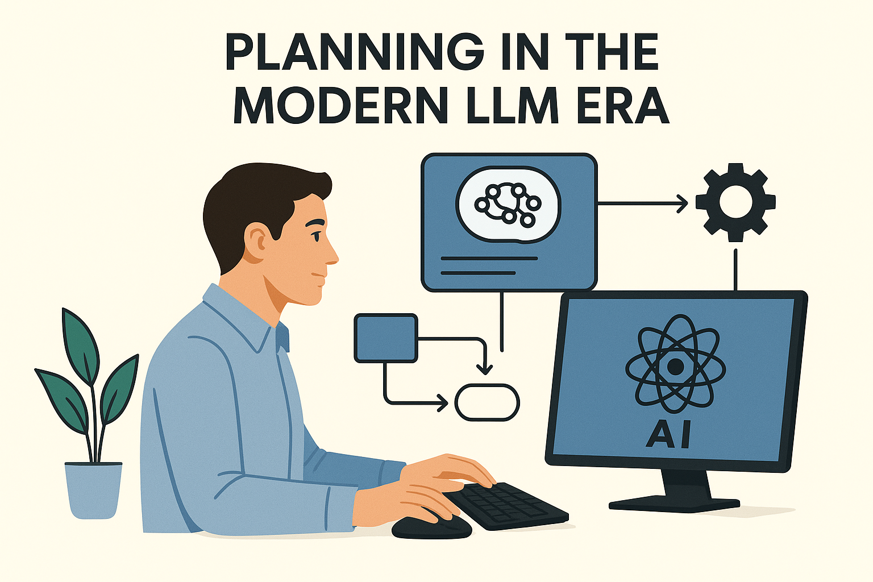

Slide 33




Building solvers for NL/PDDL planning problems
Environment
Katz et al, NeurIPS 2024
LLM as search components generator
Observation
Cao et al, ICAPS 2026
Search components code (black box model)
Tuisov et al, ICAPS 2026
Action/plan
Search
algorithm
Correa et al, NeurIPS 2025
Planning/search problem in NL
Guan et al, NeurIPS 2023
Gestrin et al, HAXP@ICAPS 2024
LLM as PDDL generator
Observation
Oswald et al, ICAPS 2024
High level planning model (PDDL)
Action/plan
Huang et al, AAAI 2025
Off-the-shelf planner
Tantakoun et al, ACL Findings 2025
Oswald et al, WM@ICLR 2026
Silver et al, AAAI 2024
Hodel, BSc Thesis 2024
LLM as policy generator
Observation
Policy code
(domain-specific planner)
Action/plan
Stein et al, ICAPS 2026
Sohrabi et al, LM4Plan@ICAPS 2026

Slide 34
World Models generation
Environment
Planning/search problem in NL

Slide 35
World Models generation
Environment
Search components code (black box model)
LLM as search components generator
Observation
Action/plan
Search
algorithm
Planning/search problem in NL

Slide 36
World Models generation
Environment
Katz et al, NeurIPS 2024
LLM as search components generator
Observation
Cao et al, ICAPS 2026
Search components code (black box model)
Correa et al, NeurIPS 2025
Action/plan
Search
algorithm
Tuisov et al, ICAPS 2026
Planning/search problem in NL

Slide 37
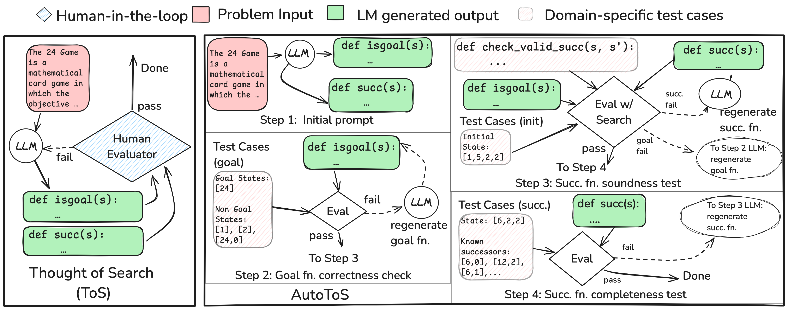
World Models generation
Environment
Katz et al, NeurIPS 2024
LLM as search components generator
Observation
Cao et al, ICAPS 2026
Search components code (black box model)
Correa et al, NeurIPS 2025
Action/plan
Search
algorithm
Tuisov et al, ICAPS 2026
Planning/search problem in NL

Slide 38
Thought of Search (ToS)
Katz et al, NeurIPS 2024

Slide 39
Thought of Search (ToS)
Katz et al, NeurIPS 2024
Plug the functions into a standard search (BFS/DFS/IDDF…)

Slide 40
Thought of Search (ToS)
Katz et al, NeurIPS 2024
Plug the functions into a standard search (BFS/DFS/IDDF…)
Results?

Slide 41
Thought of Search (ToS)
Katz et al, NeurIPS 2024
Plug the functions into a standard search (BFS/DFS/IDDF…)
Results?
100% accuracy across all tested domains!
Execution time in ms per instance

Slide 42
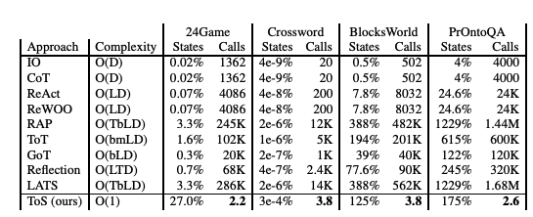
Thought of Search (ToS)
Katz et al, NeurIPS 2024
Plug the functions into a standard search (BFS/DFS/IDDF…)
Results?
100% accuracy across all tested domains!
Execution time in ms per instance

Slide 43
Thought of Search (ToS)
Katz et al, NeurIPS 2024
Plug the functions into a standard search (BFS/DFS/IDDF…)
Results?
100% accuracy across all tested domains!
Execution time in ms per instance
Limitation: need human in the loop!

Slide 44
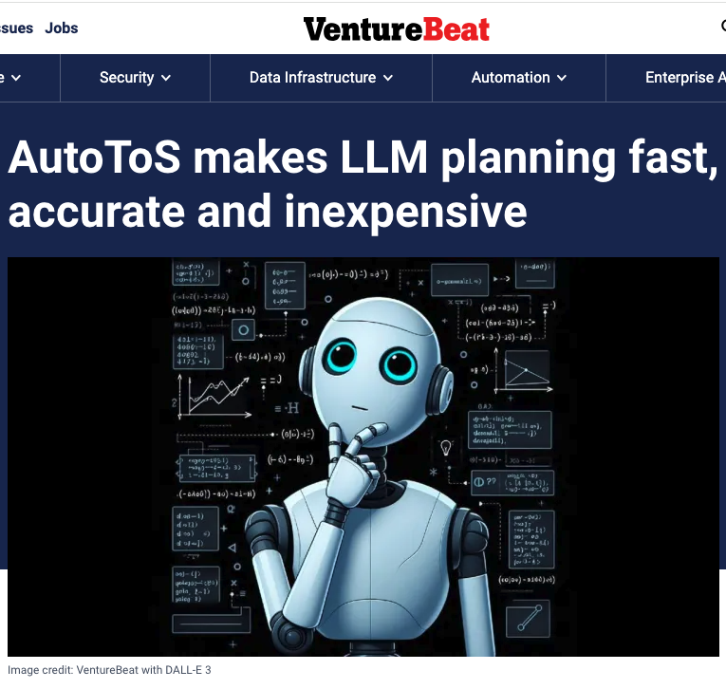
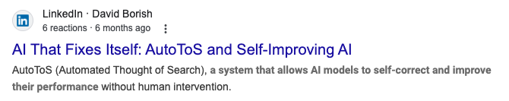
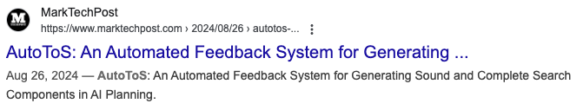

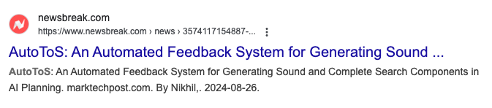
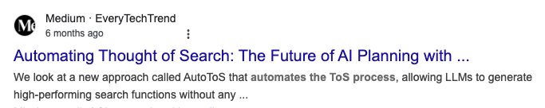
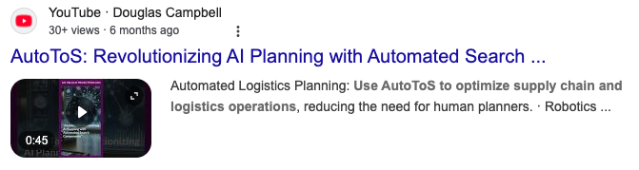
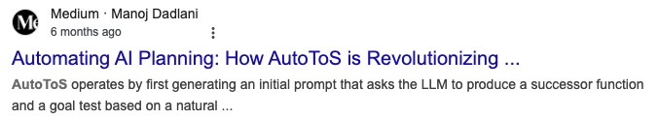
Automating Thought of Search (AutoToS)
Cao et al, ICAPS 2026

Slide 45
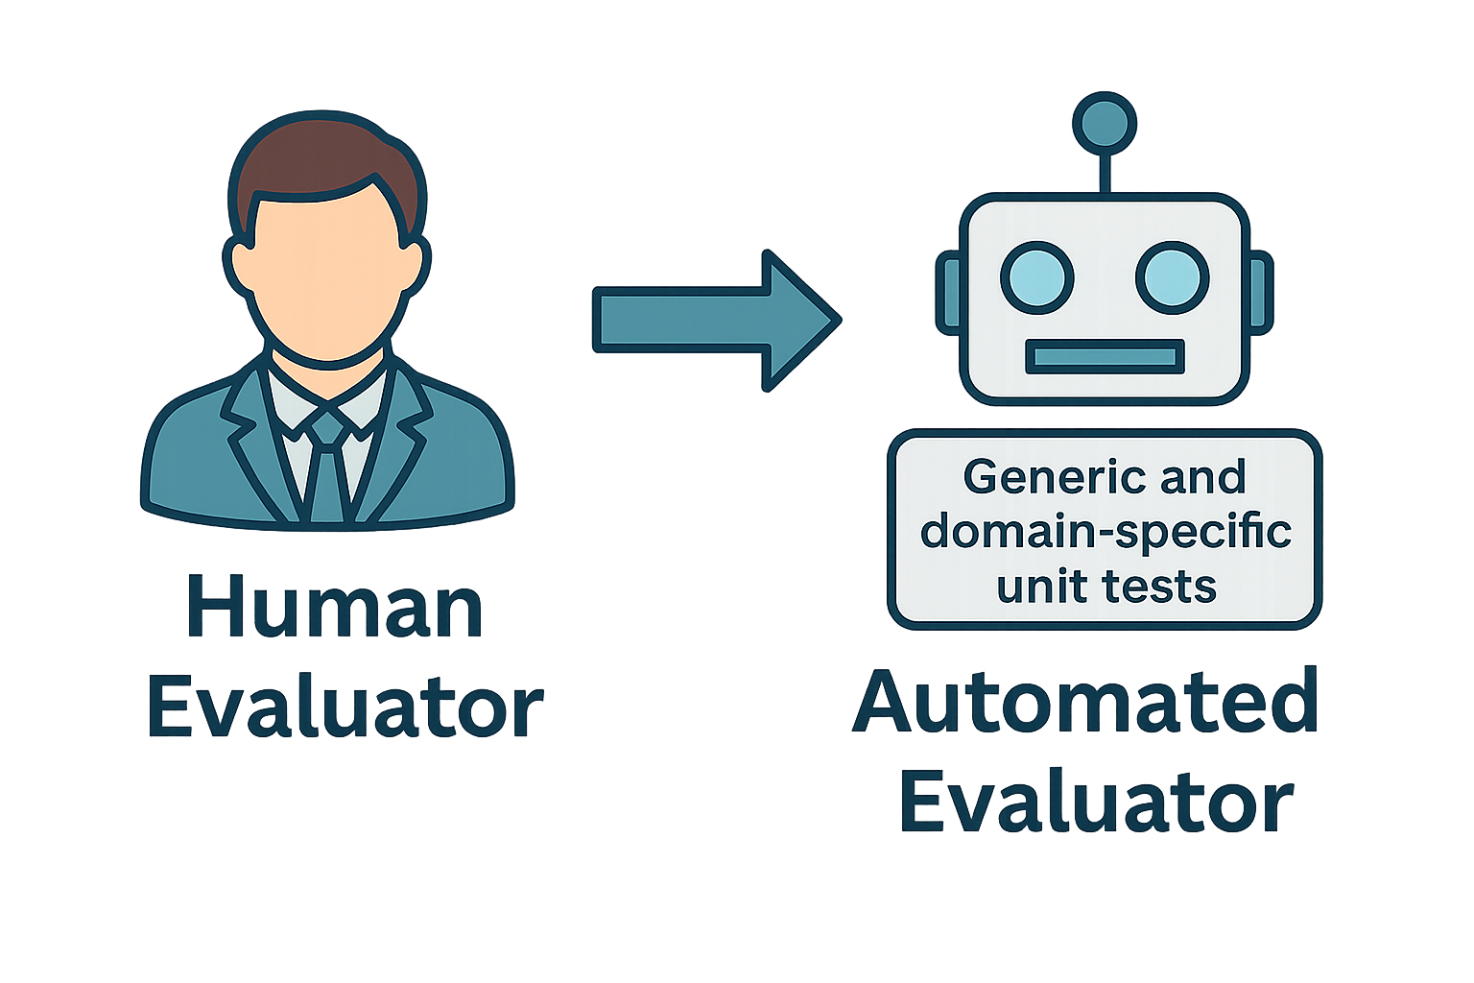
AutoToS: Core Idea

Slide 46
How does it work?

Slide 47
How does it work?

Slide 48
How does it work?

Slide 49
How does it work?

Slide 50
How does it work?

Slide 51
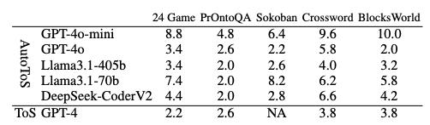
Is it much worse than a human feedback?

Slide 52
Does it match the accuracy of ToS?

Slide 53
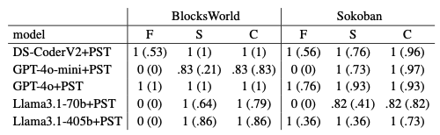
Does it match the accuracy of ToS?

Slide 54
Heuristics generation
Correa et al, NeurIPS 2025

Slide 55
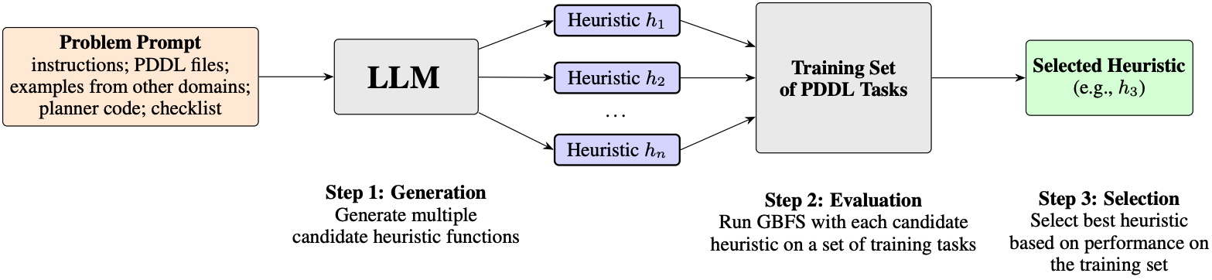
Heuristics generation
Correa et al, NeurIPS 2025

Slide 56
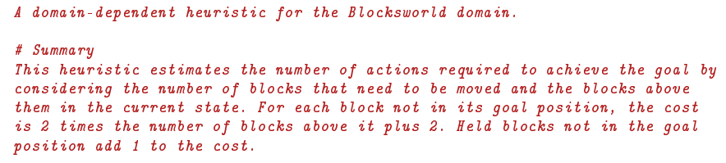
Heuristics generation
Correa et al, NeurIPS 2025

Slide 57
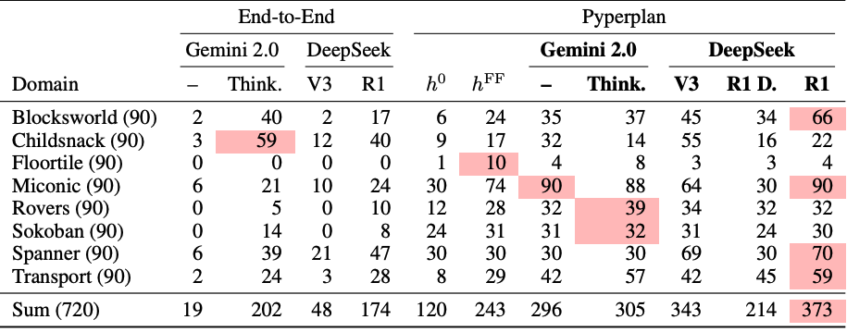
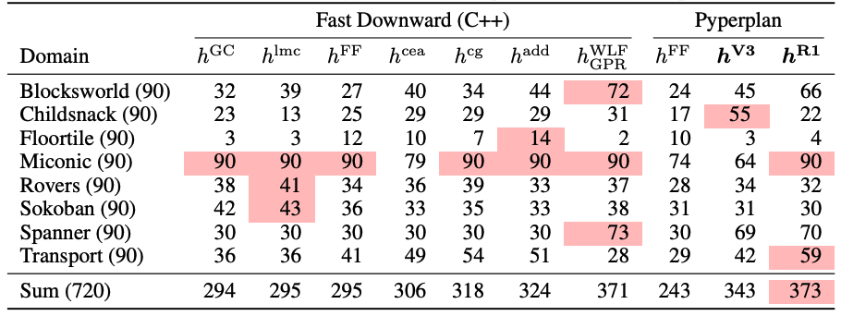
Heuristics Generation
Correa et al, NeurIPS 2025

Slide 58
Heuristics Generation
Correa et al, NeurIPS 2025

Slide 59
Heuristics Generation
Correa et al, NeurIPS 2025

Slide 60
Heuristics Generation
Correa et al, NeurIPS 2025

Slide 61
Heuristics Generation
Correa et al, NeurIPS 2025

Slide 62
Heuristics Generation
Correa et al, NeurIPS 2025

Slide 63
PDDL Generation
Environment
Planning/search problem in NL

Slide 64
PDDL Generation
Environment
Guan et al, NeurIPS 2023
Gestrin et al, HAXP@ICAPS 2024
LLM as PDDL generator
Observation
Oswald et al, ICAPS 2024
High level planning model (PDDL)
Action/plan
Huang et al, AAAI 2025
Off-the-shelf planner
Tantakoun et al, ACL Findings 2025
Oswald et al, WM@ICLR 2026
Planning/search problem in NL

Slide 65
PDDL Generation: First Attempts
Guan et al, NeurIPS 2023
LLM as PDDL generator
High level planning model (PDDL)
Off-the-shelf planner

Slide 66
PDDL Generation: First Attempts
Guan et al, NeurIPS 2023
LLM as PDDL generator
High level planning model (PDDL)
Off-the-shelf planner
PDDL

Slide 67
PDDL Generation: First Attempts
Guan et al, NeurIPS 2023
LLM as PDDL generator
High level planning model (PDDL)
Off-the-shelf planner
PDDL
Feedback
VAL

Slide 68
PDDL Generation: First Attempts
Guan et al, NeurIPS 2023
LLM as PDDL generator
High level planning model (PDDL)
Off-the-shelf planner
PDDL
Feedback
VAL

Slide 69
PDDL Generation: First Attempts
Guan et al, NeurIPS 2023
LLM as PDDL generator
High level planning model (PDDL)
Off-the-shelf planner
PDDL
Predicates
Feedback
VAL

Slide 70
PDDL Generation: First Attempts
Guan et al, NeurIPS 2023
LLM as PDDL generator
High level planning model (PDDL)
Off-the-shelf planner
Predicates

Slide 71
PDDL Generation: First Attempts
Guan et al, NeurIPS 2023
LLM as PDDL generator
High level planning model (PDDL)
Off-the-shelf planner
Predicates
PDDL
Feedback
VAL

Slide 72
PDDL Generation: First Attempts
Gestrin et al, HAXP@ICAPS 2024
LLM as PDDL generator
High level planning model (PDDL)
Off-the-shelf planner

Slide 73
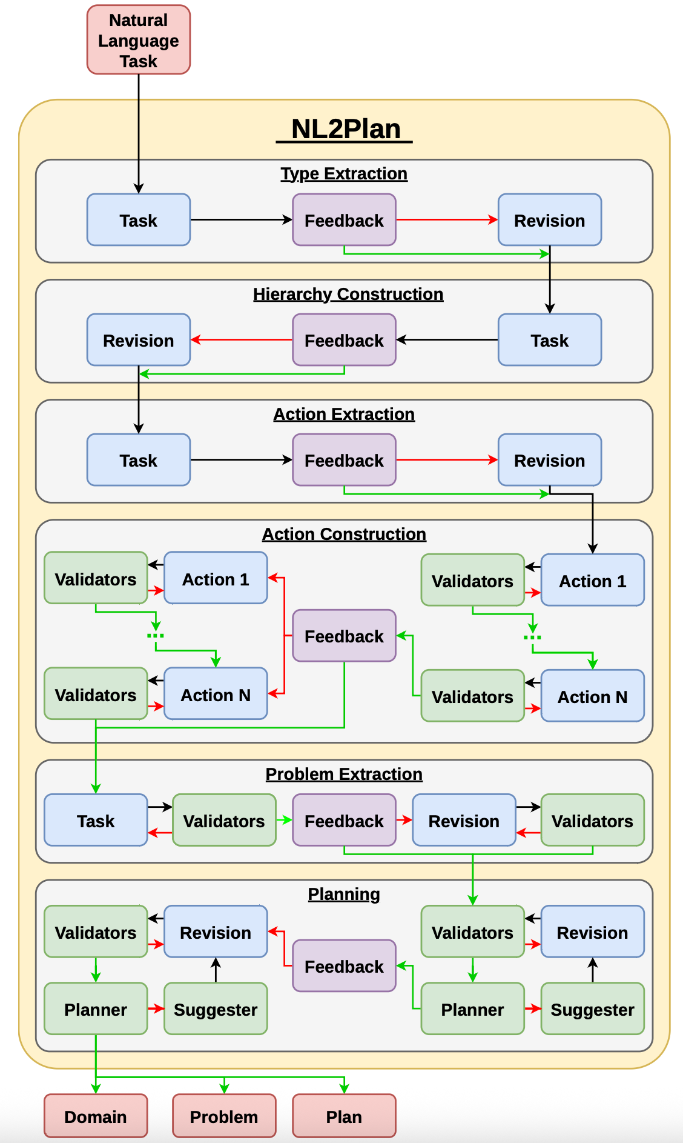
PDDL Generation: First Attempts
Gestrin et al, HAXP@ICAPS 2024
LLM as PDDL generator
High level planning model (PDDL)
Off-the-shelf planner

Slide 74
PDDL Generation: First Attempts
Gestrin et al, HAXP@ICAPS 2024
LLM as PDDL generator
High level planning model (PDDL)
Off-the-shelf planner

Slide 75
PDDL Generation: First Attempts
Gestrin et al, HAXP@ICAPS 2024
LLM as PDDL generator
High level planning model (PDDL)
Off-the-shelf planner

Slide 76
PDDL Generation: First Attempts
Gestrin et al, HAXP@ICAPS 2024
LLM as PDDL generator
High level planning model (PDDL)
Off-the-shelf planner

Slide 77
PDDL Generation: First Attempts
Gestrin et al, HAXP@ICAPS 2024
LLM as PDDL generator
High level planning model (PDDL)
Off-the-shelf planner

Slide 78
PDDL Generation
LLM as PDDL generator
High level planning model (PDDL)
Off-the-shelf planner
What is being tackled?

Slide 79
PDDL Generation
LLM as PDDL generator
High level planning model (PDDL)
Off-the-shelf planner
What is being tackled?
Syntactical correctness!

Slide 80
PDDL Generation
LLM as PDDL generator
High level planning model (PDDL)
Off-the-shelf planner
What is being tackled?
Syntactical correctness!
What about semantical correctness?

Slide 81
PDDL Generation: Tackling Semantic Correctness
Huang et al, AAAI 2025
LLM as PDDL generator
High level planning model (PDDL)
Off-the-shelf planner

Slide 82
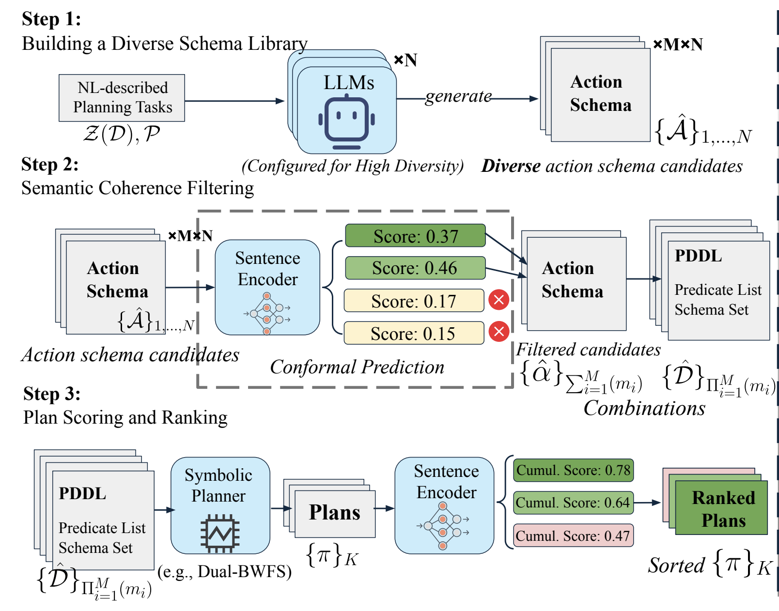
PDDL Generation: Tackling Semantic Correctness
Huang et al, AAAI 2025
LLM as PDDL generator
High level planning model (PDDL)
Off-the-shelf planner

Slide 83
PDDL Generation: Tackling Semantic Correctness
Huang et al, AAAI 2025
LLM as PDDL generator
High level planning model (PDDL)
Off-the-shelf planner

Slide 84
PDDL Generation: Tackling Semantic Correctness
Huang et al, AAAI 2025
LLM as PDDL generator
High level planning model (PDDL)
Off-the-shelf planner

Slide 85
PDDL Generation: Tackling Semantic Correctness
Huang et al, AAAI 2025
LLM as PDDL generator
High level planning model (PDDL)
Off-the-shelf planner

Slide 86
PDDL Generation: Measuring Semantic Correctness
Oswald et al, ICAPS 2024
LLM as PDDL generator
High level planning model (PDDL)
Off-the-shelf planner
Notes:
Action Reconstruction Error (from action models learning literature)
Heuristic Domain Equivalence (since we cannot compute the entire plan sets)

Slide 87
PDDL Generation: Measuring Semantic Correctness
Oswald et al, ICAPS 2024
LLM as PDDL generator
High level planning model (PDDL)
Off-the-shelf planner
PDDL
PDDL
Notes:
Action Reconstruction Error (from action models learning literature)
Heuristic Domain Equivalence (since we cannot compute the entire plan sets)

Slide 88
PDDL Generation: Measuring Semantic Correctness
Oswald et al, ICAPS 2024
LLM as PDDL generator
High level planning model (PDDL)
Off-the-shelf planner
PDDL
How to measure semantic equivalence?
PDDL
Notes:
Action Reconstruction Error (from action models learning literature)
Heuristic Domain Equivalence (since we cannot compute the entire plan sets)

Slide 89
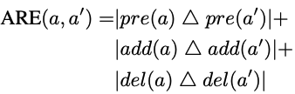
PDDL Generation: Measuring Semantic Correctness
Oswald et al, ICAPS 2024
LLM as PDDL generator
High level planning model (PDDL)
Off-the-shelf planner
PDDL
How to measure semantic equivalence?
PDDL
ARE
Notes:
Action Reconstruction Error (from action models learning literature)
Heuristic Domain Equivalence (since we cannot compute the entire plan sets)

Slide 90
PDDL Generation: Measuring Semantic Correctness
Oswald et al, ICAPS 2024
LLM as PDDL generator
High level planning model (PDDL)
Off-the-shelf planner
PDDL
How to measure semantic equivalence?
PDDL
plans
plans
HDE
Notes:
Action Reconstruction Error (from action models learning literature)
Heuristic Domain Equivalence (since we cannot compute the entire plan sets)

Slide 91
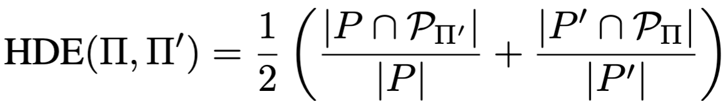
PDDL Generation: Measuring Semantic Correctness
Oswald et al, ICAPS 2024
LLM as PDDL generator
High level planning model (PDDL)
Off-the-shelf planner
PDDL
How to measure semantic equivalence?
PDDL
plans
plans
HDE
Notes:
Action Reconstruction Error (from action models learning literature)
Heuristic Domain Equivalence (since we cannot compute the entire plan sets)

Slide 92
PDDL Generation: Beyond Single Loop
LLM as PDDL generator
High level planning model (PDDL)
Off-the-shelf planner
Oswald et al, WM@ICLR 2026
Notes:
Action Reconstruction Error
Heuristic Domain Equivalence

Slide 93
PDDL Generation: Beyond Single Loop
LLM as PDDL generator
High level planning model (PDDL)
Off-the-shelf planner
PDDL
Oswald et al, WM@ICLR 2026
Notes:
Action Reconstruction Error
Heuristic Domain Equivalence

Slide 94
PDDL Generation: Beyond Single Loop
LLM as PDDL generator
High level planning model (PDDL)
Off-the-shelf planner
PDDL
VAL
Oswald et al, WM@ICLR 2026
Notes:
Action Reconstruction Error
Heuristic Domain Equivalence

Slide 95
PDDL Generation: Beyond Single Loop
LLM as PDDL generator
High level planning model (PDDL)
Off-the-shelf planner
PDDL
VAL
plans
Oswald et al, WM@ICLR 2026
Notes:
Action Reconstruction Error
Heuristic Domain Equivalence

Slide 96
PDDL Generation: Beyond Single Loop
LLM as PDDL generator
High level planning model (PDDL)
Off-the-shelf planner
PDDL
VAL
plans
landmarks
Oswald et al, WM@ICLR 2026
Notes:
Action Reconstruction Error
Heuristic Domain Equivalence

Slide 97
PDDL Generation: Beyond Single Loop
LLM as PDDL generator
High level planning model (PDDL)
Off-the-shelf planner
Semantic feedback – many forms
PDDL
VAL
plans
landmarks
Oswald et al, WM@ICLR 2026
Notes:
Action Reconstruction Error
Heuristic Domain Equivalence

Slide 98
PDDL Generation: Beyond Single Loop
LLM as PDDL generator
High level planning model (PDDL)
Off-the-shelf planner
Semantic feedback – many forms
This sequence of actions should have been a plan
PDDL
VAL
plans
landmarks
Oswald et al, WM@ICLR 2026
Notes:
Action Reconstruction Error
Heuristic Domain Equivalence

Slide 99
PDDL Generation: Beyond Single Loop
LLM as PDDL generator
High level planning model (PDDL)
Off-the-shelf planner
Semantic feedback – many forms
This sequence of actions should have been a plan
This sequence of actions should have not been a plan
PDDL
VAL
plans
landmarks
Oswald et al, WM@ICLR 2026
Notes:
Action Reconstruction Error
Heuristic Domain Equivalence

Slide 100
PDDL Generation: Beyond Single Loop
LLM as PDDL generator
High level planning model (PDDL)
Off-the-shelf planner
Semantic feedback – many forms
This sequence of actions should have been a plan
This sequence of actions should have not been a plan
PDDL
This set of actions should have been a landmark
VAL
plans
landmarks
Oswald et al, WM@ICLR 2026
Notes:
Action Reconstruction Error
Heuristic Domain Equivalence

Slide 101
PDDL Generation: Beyond Single Loop
LLM as PDDL generator
High level planning model (PDDL)
Off-the-shelf planner
Semantic feedback – many forms
This sequence of actions should have been a plan
This sequence of actions should have not been a plan
PDDL
This set of actions should have been a landmark
VAL
We can branch on the feedback given to the model!
plans
landmarks
Oswald et al, WM@ICLR 2026
Notes:
Action Reconstruction Error
Heuristic Domain Equivalence

Slide 102
PDDL Generation: Beyond Single Loop
LLM as PDDL generator
PDDL
High level planning model (PDDL)
Off-the-shelf planner
Semantic feedback – many forms
This sequence of actions should have been a plan
This sequence of actions should have not been a plan
PDDL
This set of actions should have been a landmark
VAL
We can branch on the feedback given to the model!
plans
landmarks
Oswald et al, WM@ICLR 2026
Notes:
Action Reconstruction Error
Heuristic Domain Equivalence

Slide 103
PDDL Generation: Beyond Single Loop
LLM as PDDL generator
PDDL
High level planning model (PDDL)
Off-the-shelf planner
Feedback
Semantic feedback – many forms
This sequence of actions should have been a plan
This sequence of actions should have not been a plan
PDDL
This set of actions should have been a landmark
VAL
We can branch on the feedback given to the model!
plans
landmarks
Oswald et al, WM@ICLR 2026
Notes:
Action Reconstruction Error
Heuristic Domain Equivalence

Slide 104
PDDL Generation: Beyond Single Loop
LLM as PDDL generator
PDDL
High level planning model (PDDL)
Off-the-shelf planner
Feedback
Feedback
Semantic feedback – many forms
This sequence of actions should have been a plan
This sequence of actions should have not been a plan
PDDL
This set of actions should have been a landmark
VAL
We can branch on the feedback given to the model!
plans
landmarks
Oswald et al, WM@ICLR 2026
Notes:
Action Reconstruction Error
Heuristic Domain Equivalence

Slide 105
PDDL Generation: Beyond Single Loop
LLM as PDDL generator
PDDL
High level planning model (PDDL)
Off-the-shelf planner
Feedback
Feedback
Feedback
Semantic feedback – many forms
This sequence of actions should have been a plan
This sequence of actions should have not been a plan
PDDL
This set of actions should have been a landmark
VAL
We can branch on the feedback given to the model!
plans
landmarks
Oswald et al, WM@ICLR 2026
Notes:
Action Reconstruction Error
Heuristic Domain Equivalence

Slide 106
PDDL Generation: Beyond Single Loop
LLM as PDDL generator
PDDL
High level planning model (PDDL)
Off-the-shelf planner
Feedback
Feedback
Feedback
Semantic feedback – many forms
This sequence of actions should have been a plan
This sequence of actions should have not been a plan
PDDL
PDDL
PDDL
PDDL
This set of actions should have been a landmark
VAL
We can branch on the feedback given to the model!
plans
landmarks
Oswald et al, WM@ICLR 2026
Notes:
Action Reconstruction Error
Heuristic Domain Equivalence

Slide 107
PDDL Generation: Beyond Single Loop
LLM as PDDL generator
PDDL
High level planning model (PDDL)
Off-the-shelf planner
Feedback
Feedback
Feedback
Semantic feedback – many forms
This sequence of actions should have been a plan
This sequence of actions should have not been a plan
PDDL
PDDL
PDDL
PDDL
This set of actions should have been a landmark
Feedback
Feedback
Feedback
Feedback
VAL
Feedback
Feedback
Feedback
Feedback
Feedback
We can branch on the feedback given to the model!
plans
landmarks
Oswald et al, WM@ICLR 2026
Notes:
Action Reconstruction Error
Heuristic Domain Equivalence

Slide 108
PDDL Generation: Beyond Single Loop
LLM as PDDL generator
PDDL
High level planning model (PDDL)
Off-the-shelf planner
Feedback
Feedback
Feedback
Semantic feedback – many forms
This sequence of actions should have been a plan
This sequence of actions should have not been a plan
PDDL
PDDL
PDDL
PDDL
This set of actions should have been a landmark
Feedback
Feedback
Feedback
Feedback
VAL
Feedback
Feedback
Feedback
Feedback
Feedback
We can branch on the feedback given to the model!
plans
landmarks
PDDL
PDDL
PDDL
PDDL
PDDL
PDDL
PDDL
PDDL
PDDL
Oswald et al, WM@ICLR 2026
Notes:
Action Reconstruction Error
Heuristic Domain Equivalence

Slide 109
Generalized Policy Generation
Environment
Silver et al, AAAI 2024
LLM as policy generator
Observation
Hodel, BSc Thesis 2024
Policy code
(domain-specific planner)
Action/plan
Stein et al, ICAPS 2026
Sohrabi et al, LM4Plan@ICAPS 2026
Planning/search problem in NL

Slide 110
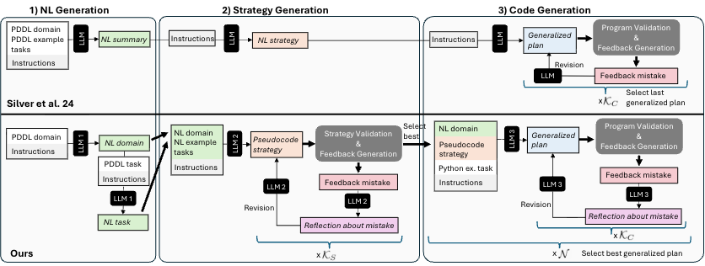
Generalized Policy Generation
Environment
Silver et al, AAAI 2024
LLM as policy generator
Observation
Hodel, BSc Thesis 2024
Policy code
(domain-specific planner)
Action/plan
Stein et al, ICAPS 2026
Sohrabi et al, LM4Plan@ICAPS 2026
Planning/search problem in NL
Silver et al, AAAI 2024
Stein et al, ICAPS 2026

Slide 111
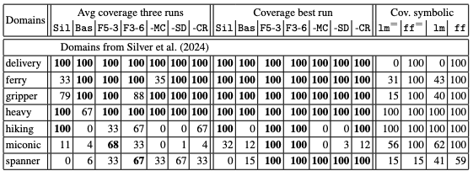
Generalized Policy Generation
Stein et al, ICAPS 2026

Slide 112
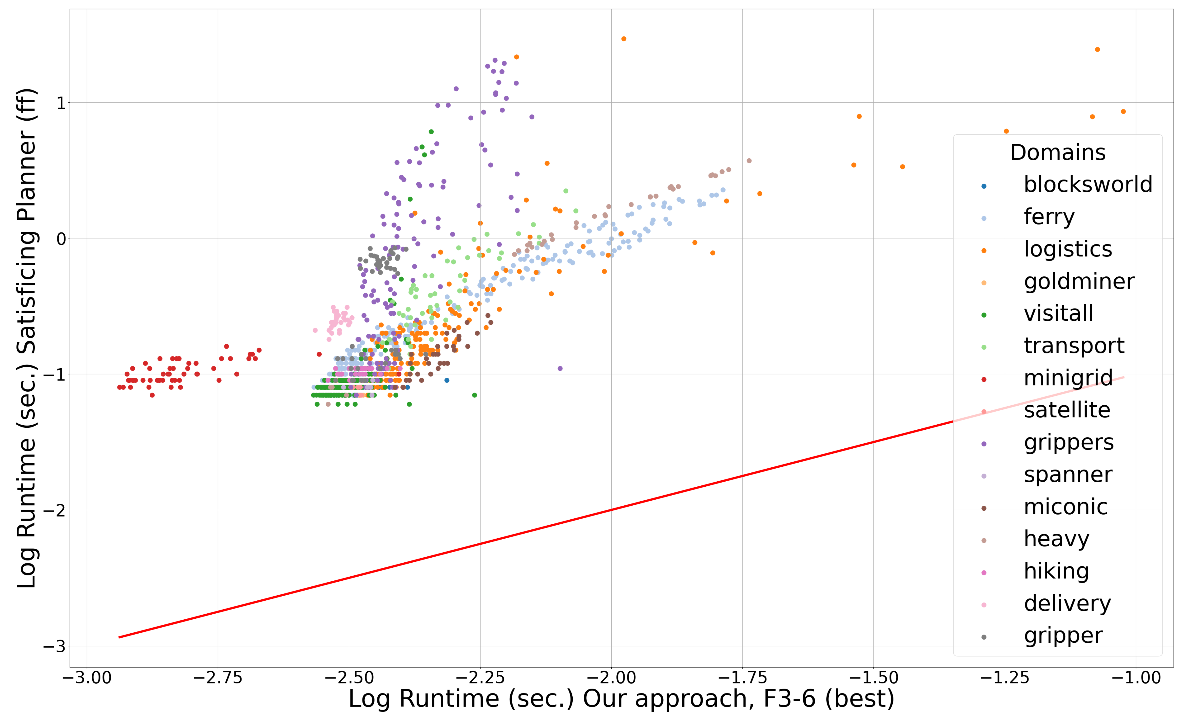
Generalized Policy Generation
Stein et al, ICAPS 2026

Slide 113
Generalized Policy Generation with Reuse
Three stages, each guarded by validation:
Generate policy: abstract tasks, infer signature, bind parameters, retrieve skills, synthesize code
Sohrabi et al, LM4Plan@ICAPS 2026
Notes:
1. Generate policy
2. Learn reusable components
3. Generalize components

Slide 114
Generalized Policy Generation with Reuse
Three stages, each guarded by validation:
Learn Skills: decompose successful policies into reusable functions and revalidate updated policies
Sohrabi et al, LM4Plan@ICAPS 2026
Notes:
1. Generate policy
2. Learn reusable components
3. Generalize components

Slide 115
Generalized Policy Generation with Reuse
Three stages, each guarded by validation:
Generalize Skills: cluster, deduplicate, abstract, and validate before adding to the repository
Sohrabi et al, LM4Plan@ICAPS 2026
Notes:
1. Generate policy
2. Learn reusable components
3. Generalize components

Slide 116
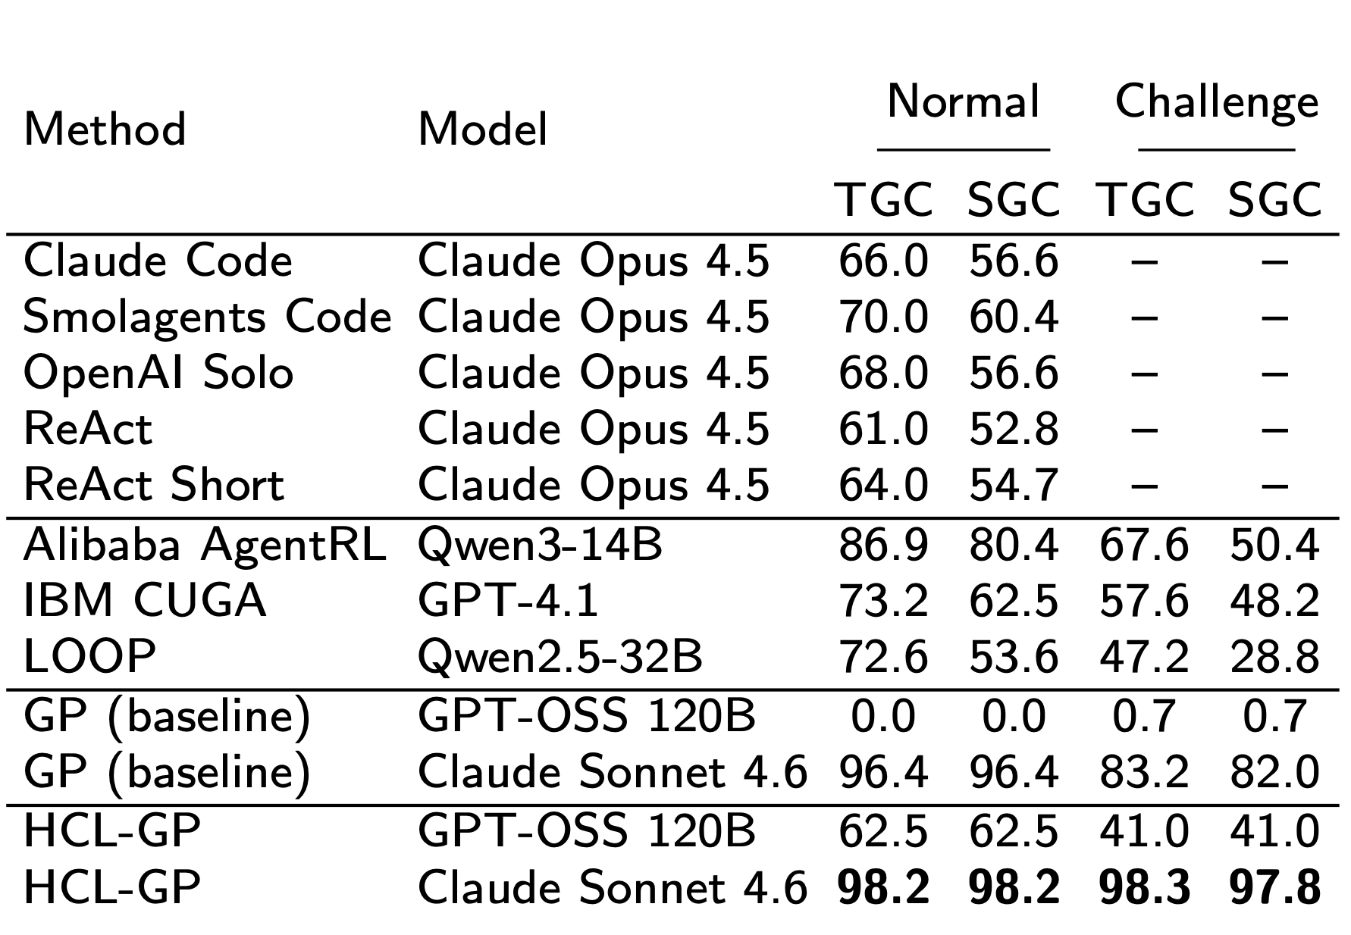

Generalized Policy Generation with Reuse: Results
AppWorld
Sohrabi et al, LM4Plan@ICAPS 2026
Notes:
1. Generate policy
2. Learn reusable components
3. Generalize components

Slide 117
Generalized Policy Generation with Reuse: Results
AppWorld
Sohrabi et al, LM4Plan@ICAPS 2026
Notes:
1. Generate policy
2. Learn reusable components
3. Generalize components

Slide 118
Generalized Policy Generation with Reuse: Results
AppWorld
Sohrabi et al, LM4Plan@ICAPS 2026
Notes:
1. Generate policy
2. Learn reusable components
3. Generalize components

Slide 119
Generalized Policy Generation with Reuse: Results
AppWorld
Sohrabi et al, LM4Plan@ICAPS 2026
Notes:
1. Generate policy
2. Learn reusable components
3. Generalize components

Slide 120
Generalized Policy Generation with Reuse: Results
Sohrabi et al, LM4Plan@ICAPS 2026
Notes:
1. Generate policy
2. Learn reusable components
3. Generalize components

Slide 121
Generalized Policy Generation with Reuse: Results
Sohrabi et al, LM4Plan@ICAPS 2026
Notes:
1. Generate policy
2. Learn reusable components
3. Generalize components

Slide 122
Generalized Policy Generation with Reuse: Results
Sohrabi et al, LM4Plan@ICAPS 2026
Notes:
1. Generate policy
2. Learn reusable components
3. Generalize components

Slide 123


